Slide 1
Logistics Pack
EU-ToxRisk Final Symposium
3 - 4 November 2021
The Square, Brussels, Belgium
Grant agreement no. 681002

Slide 2
Covid 19_Event Safety Guidelines
Sanitary guidelines 2020 SQUARE BRUSSELS CONVENTION CENTRE
(https://www.square-brussels.com/en/sanitary-measures-2020.html)
COVID Certificate
You will need to present your EU Digital COVID Certificate to enter the Convention Centre.
Mandatory form for travel to Belgium
Persons travelling through Belgium and who are staying at least 48 hours must fill out an electronic Passenger Locator Form (e-PLF) regardless of their departure point and nationality.
The form has to be completed prior to your arrival, but not more than 48 hours before reaching Belgium. You can find this form here (link is external).
Information regarding the Covid-19 health guidelines is available on www.info-coronavirus.be.

Slide 3
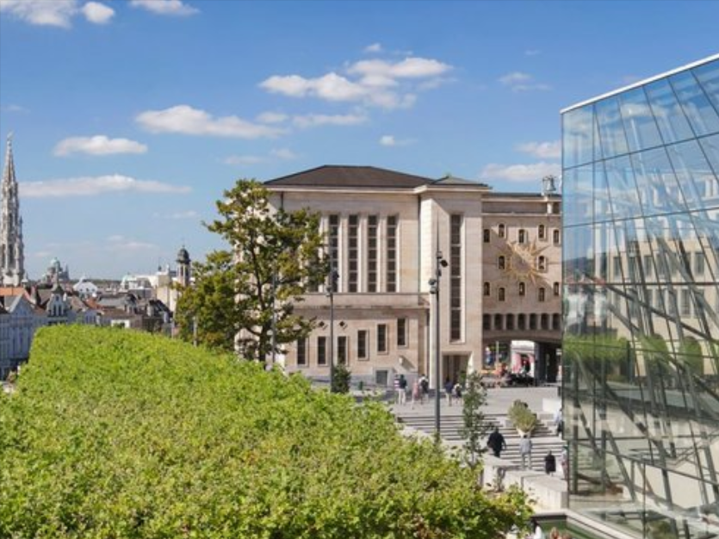
Venue
SQUARE - Brussels Convention Centre
Glass Entrance Mont des Arts/Kunstberg B-1000 Brussels T: +32 2 515 13 00
Contact Details:
EU-ToxRisk Project Office: eu-toxrisk-arttic@eurtd.com.

Slide 4
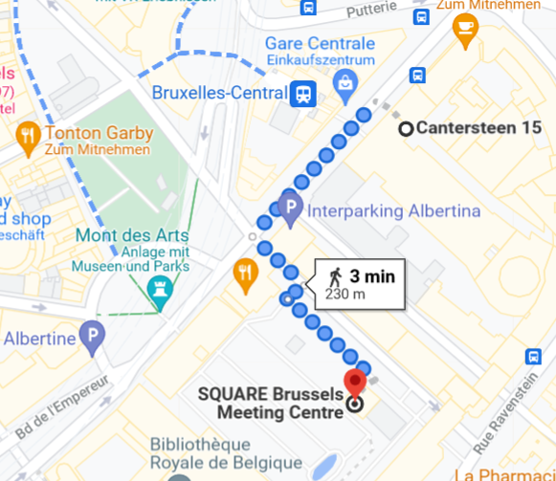
How To Get to the venue (SQUARE) - Itineraries (I)
Coming by plane / Brussels Airport (BRU) - Zaventem
SQUARE is very close to the capital's main transport hub, Central Station, which has a direct and fast train connection to Brussels Airport. Local train, tram, metro and bus lines all converge at Central Station, providing access to the entire city and rest of the country. Brussels Central Station is only 3 minutes walk to SQUARE.
Brussels airport - city transfer
By taxi
The journey takes around 20 min on light traffic.
Costs €45 - €50.
By train
There is a train service from Brussels Zaventem Airport to Brussels Central Station every 10 minutes between 5am and midnight, 7 days a week.
The ride takes 18 minutes and costs €9,1.
The train station is located at Level -1. The platform is easily reached by lift or escalator.
Belgian Railways (NMBS/SNCB) website: belgiantrain.be.
By bus
Every airport bus departs and arrives at the bus station at Level 0. The Airport Line is a public transport Brussels airport bus that takes you to the European district, Luxemburg station and to the city center. Line 12 (operates Mon-Fri until 8pm) travels only to the main stations of Brussels and the last stop is Trone. Tickets cost €7.5 and the journey takes around 40 min.
STIB website: stib-mivb.be
Brussels Central Station
(Brux.-Central station)

Slide 5
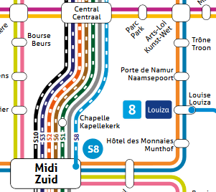
How To Get to the venue (SQUARE) - Itineraries (II)
Coming by train / Brussels-Midi/Zuid train station (Brussels South)
SQUARE is very close to the capital's main transport hub, Central Station, which has a direct and fast train connection to Brussels Airport. Local train, tram, metro and bus lines all converge at Central Station, providing access to the entire city and rest of the country. Brussels Central Station is only 3 minutes walk to SQUARE.
By train
There are direct trains departing from Brussels, Gare du Midi to Brussels Central Station (IC or S trains).
Journey time is 3 minutes and covers a distance of around 2 km. €2,50 per ticket.
Belgian Railways (NMBS/SNCB) website: belgiantrain.be.
By metro
From Brussels, Gare du Midi, you can take lines 2 or 6 (direction Elisabeth), change at Arts-Loi for line 1 or 5 (towards Gare de l’oust / Erasme) and stop at Brussels Central Station.
Journey time about 12-15 min. €2-3 per ticket.
STIB website: stib-mivb.be
Brussels Central Station
(Brux.-Central station)

Slide 6
Accommodation
Hotels***
IBIS Brussels off Grand Place Hotel
Grasmarkt 100, Rue du Marché aux Herbes 100, 1000 Bruxelles; 📞: +32 2 620 0 427
Rates for single use : ~100 € /room/night (breakfast included)
Distance to venue: 400 m (5 min by car/6 min walking)
Hotel Floris Arlequin Grand-Place
Rue De La Fourche 17-19, 1000 Bruxelles; 📞: +32 2 514 16 15
Rates for single use : ~103,00 € /room/night (breakfast included)
Distance to venue: 700 m (11 min by public transport/9 min walking)
Hotel Saint Nicolas
Rue Marché aux Poulet 32, 1000 Bruxelles; 📞: +32 2 219 04 40
Rates for single use : ~110,00 € /room/night (breakfast included)
Distance to venue: 800 m (11 min by public transport/10 min walking)
Motel One Brussels
Rue Royale 120, 1000 Bruxelles ; 📞: +32 2 209 61 10
Rates for single use : ~100,00 € /room/night (breakfast included)
Distance to venue: 850 m (5 min by car /9 min walking)
Hotels****
Hilton Brussels Grand Place
Carrefour de l Europe 3, 1000 Brussels, 📞: +32 2 548 42 11
Rates for double use: 190 €/room/night (breakfast included)
Distance to venue: 300 m (4 min walking time)
NH Collection Brussels Grand Sablon
Rue Bodenbroekstraat 2-4, 1000 Brussels; 📞: +32 2 518 11 00
Rates for double use: ~190€ / room/ night (online, with breakfast)
Distance to venue: 650 m (4 min by car/ 7 min walking)
NH Brussels Grand Place Arenberg
Rue d'Assaut 15, 1000 Brüssel; 📞: 32 2 501 16 16
Rates for single use: ~150€ /room/night (breakfast included)
Distance to venue: 650m (10 min by car/ 8 min walking)
Novotel Brussels City Centre
Rue de la Vierge Noire 32, 1000 Brüssel; 📞: +32 2 620 04 28
Rates for single use: ~114€ /room/night (breakfast included)
Distance to venue: 1000m (10 min by public transport/ 14 min walking)
Rates can be subjected to changes.
City tax not included.

