Slide 1
WP X
[Presenters]
Engine ITD Annual Review
June 5-8, 2018
Madrid, Spain
Innovation Takes Off

Slide 2
WPX Contents
Reviewers’ recommendations
Scope & Objectives
Master Plan
Project Finances
Project Plan
Technical Updates ( WPX.X …)
CfP project included in Demo
Future Plans
Project Risks
Conclusions
Please update accordingly

Slide 3
WP X – Answer to Reviewers’ Recommendations
Reviewers’ Recommendations | Answers
Recommendation ref. | ….
To be answered in the table above! Please refer to the Reviewers Report

Slide 4
WPx Programme Overview
State objectives and success criteria
A restatement of the existing predicted improvements in CO2, NOx and noise level, based on the example below; please insert your WP environmental objectives taken from the descriptive part in GAM#4.
Please indicate which baseline is used as reference for the target values you will list in the table?
Subsystem | Environmental targets (wrt reference)
 | CO2 [%] | NOx [%] | Noise [EPNdB]
Composite fan system | -1 to -3 | N/A (*) | -1 to -3
Advanced integrated externals | -0.5 to -1.5 | N/A | 0
Intercase structures | (**) | N/A | 0
Low weight low pressure turbine | -1 to -2 | N/A | 0
This is an example, please refer to descriptive part of your WP description in the GAM#4 as there is no descriptive part in the GAM#5 on GMT2; or refer to the JTP

Slide 5
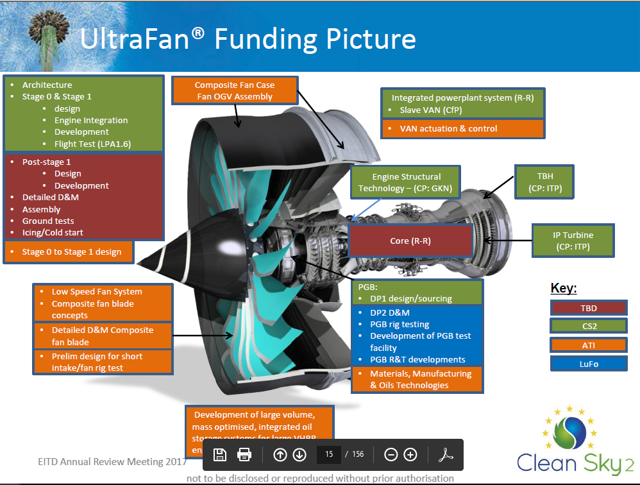
This is an example from presentations given at the #3 AR Meeting in June 2017 and answering to the reviewers’ recommendations.
Please include CP activities to this slide!
“Visibility of all funding streams aligned to anticipated engine architecture showing technologies or major engine components should be provided for all work packages “

Slide 6
WPX Master Plan
Work Breakdown Structure and roles / responsibilities of each participant (Leaders and Core Partners) with a clear definition of roles foreseen for other participants [CfP and CfT areas]
Temporal scheduling and Key Milestones (for the duration of the CS2 Programme)
Definition of demonstrator scope and test / demo campaign activity
  Flight testing including all preliminary reviews and “permit to fly” requirements
  Ground tests including all preliminary reviews and release requirements
  Simulation activity
  Verification and Validation
  Data analysis, and evidence of the feedback loop into the Technology Evaluator and to the Transverse Activity areas SAT and ECO where applicable

Slide 7
Leaders Involvement in CS2 (WP0)
LEADER | AIR | LPA | REG | SYS | EITD | TA
Airbus
SAFRAN |  | XYZ Engine Supporting Flight test |  |  | WP2 UHPE WP3 engine demo
Rolls Royce |  |  |  |  | WP5 WP6
Liebherr
MTU |  |  |  |  | WP4 ICD Rig WP4 2SC Rig WP4 Engine Demo
To be taken from the last review

Slide 8
CP Involvement in EITD (WP0)
Core Partner | WP2 | WP3 | WP4 | WP5 | WP6 | ….
DLR |  |  | ICD Rig Test 2SC Rig
GKN |  |  | ICD Rig LPC Demo Exhaust
ITP
GE Avio
….
To be completed by WP leaders but will only presented in WP0

Slide 9
WPx Project Finances
Spending Profile:
Add explanations here
Based on validated 2017 Forms C + Q1-2018 estimates
Will be provided at a later stage to WP leaders

Slide 10
WPX Project Plan
Please list the main Deliverables and Milestones of your WP based on the GAM in the table below and indicate their current status.
Key DL or Mil | Beneficiary | GAM Target Date | Status

Slide 11
WPx Project Plan
Show baseline plan from as shown at Annual Review #3 (June 2017). Please use the format enclosed in the excel file attached in the slide
Add current status, if different from June 2017, highlight gains and slips
State project changes (one Slide, if needed), since last review
  First, those agreed with JU
  Second, those proposed
Regarding delays, please state reasons of delays and highlight impact of delays

Slide 12
Main risks
  ???????
 | T*
Risk
  Probability
Mitigation
???????
  Severity
Risk
  ???????
Please list you top 3-5 risks from the GAM
  Probability
Mitigation
???????
  Severity
Risk
  ???????
  Probability
Mitigation
???????
  *Please indicate the location of your risk in the right-handed chart. Please also indicate whether your risk relates to “technical”, “resources”, “costs” or “schedule”, see example.
  Severity
EITD Annual Review Meeting 2018
Proprietary Information
not to be disclosed or reproduced without prior authorisation

Slide 13
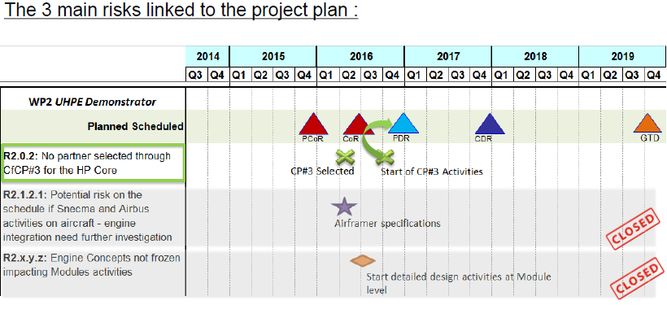
WPX Impact of risks on project schedules
This is an example from presentations given at the #2 AR Meeting in Sept. 2016
This slide should relate to the previous one and list the top 3 challenges / risks which may impact the delivery of the planned demonstrator.
It should also include an impact statement, i.e. impact of delay in other projects from which you need input

Slide 14
WPX Technical Presentation
What progresses have been made since June 2017? Please summarize progress status until June 2017 and focus on progresses made since then and up to May 2018.
Show results and evidence of progress
  Give confidence that the project plans presented will be delivered and there is substance behind the claims
  Whenever feasible, show evidence of hardware components, short videos of test activities
Only show a maximum of 30 slides for this section. The whole presentation should have an average of max. 50 to 60 slides. Additional slides can be included but should be hidden for the presentation.

Slide 15
WPX TRL Status
CS2 Development Plan |  |  | TRL status at CS2 start | Current Status
Demonstrator / Technology Stream | Technologies | Completed by
Demonstrator 2 - UHPE | Design, development and ground tests of a propulsion system demonstrator for an Ultra High By-pass Ratio engine: validation of the low pressure modules and nacelle technology | TRL 5 (2021)
Demonstrator 3 - Business aviation / short range Regional TP Demonstrator | Design, development and ground testing of a new turboprop engine demonstrator for business aviation and short range regional application | TRL5/6 (2020)
Demonstrator 4 - Adv. Geared Engine Configuration (HPC-LPT) | Design, development and ground testing of an engine demonstrator: improvement of the thermodynamic cycle efficiency and noise reduction Design, build and test of a compression system rig for interaction optimization of low pressure, static structures and high pressure modules | TRL5/6 (2020)
Demonstrator 5 - VHBR – Middle of Market Technology | ‒ behaviour of fans at low speeds and fan pressure ratios (e.g. fan stall margin, variable cold nozzle geometries) and structural technology ‒ aerodynamic and structural design of low pressure turbines for high speed operation ‒ Systems Integration of novel accessory and power gearboxes, including oil system and bearing technologies. ‒ optimised power plant (e.g integration of engine and nacelle structures, externals and dressings, Noise, Logistic & Build challenges) ‒ compressor efficiency ‒ control & electrical power system technology developments | TRL 4/5 2018
Demonstrator 6 - VHBR – Large Turbofan Demonstrator UltraFan™ | ‒ integrated low pressure system for a high power very-high bypass ratio engine (fan, compressor, gearbox, LP turbine, VAN) ‒ engine core optimisation and integration ‒ optimised control systems ‒ ground and flight test of Large VHBR engine | Engine Demo 2017-2021
Demonstrator 7 - Small Aircraft Engine Demonstrator | ‒ light weight and fuel efficient diesel engines | TRL 6 - 2020
Demonstrator 8 - Reliable and more efficient operation of small turbine engines | ‒ reliable and more efficient operation of small turbine engines | TRL 5 2018
Please refer to summary of major demonstrators developments and enabling technologies in the CS2 DP Part B and Part C table 6. and update the table accordingly.
Recommendation G#1: “TRL’s should be evident for all work package technologies showing clearly status at CS start and current status. Where applicable Manufacturing or Systems readiness levels should be provided.”

Slide 16
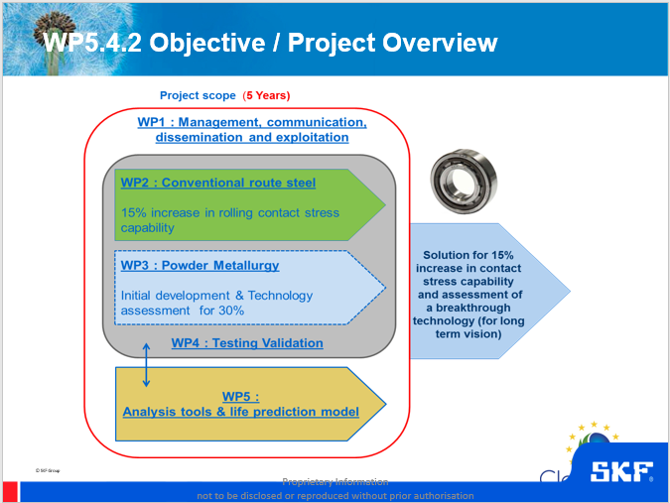
WPX CfP projects
One graphical slide per WPX
See example from AR#3 2017

Slide 17
WP0: Dissemination
Please list in the table below your WP dissemination activities
Name of the Dissemination/Comm Activity | Place | Start Date | End Date | Type of dissemination and comm. activities | Type of audiance reached | Estimated Number of persons reached
To be completed by WP leaders but presented at EITD level in WP0 presentation.

Slide 18
WPX Future Plans
Future plans for the next six months? Please focus on the most relevant upcoming achievement in the next 6 months.

Slide 19
WPx Conclusions
Summary of WP presentation

Slide 20


Innovation Takes Off

